Slide 1
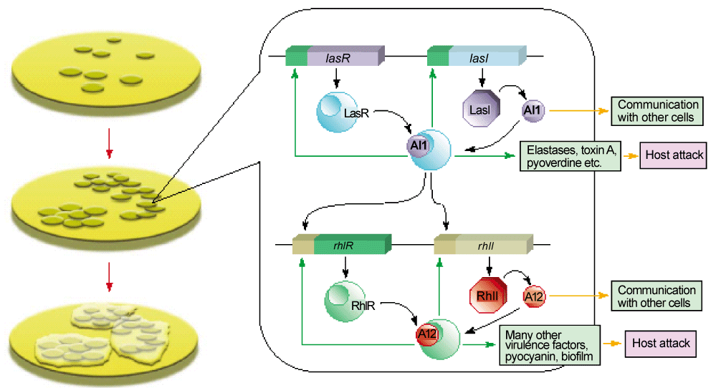
Figure 4: Activity of Pseudomonas aeruginosa QS.

